Slide 1
Agenda
What is Cloud Computing ?
Different perspectives
Properties and characteristics
Benefits from cloud computing
Service and deployment models
Three service models
Four deployment models

Slide 2
Before cloud computing, organizations used on-premises infrastructure to meet their computing needs. This meant that organizations:
Owned and operated their own computer systems and physical components
Stored their equipment in their own buildings, called data centers
Bought and maintained their own servers, storage, switches, networks, and routers
Stored and protected their own data on physical storage devices

Slide 3
Some key developments that led to cloud computing include:
Time-sharing
In the 1960s, time-sharing allowed many users to access a large mainframe computer simultaneously through remote terminals.
Minicomputers
In the 1970s, minicomputers like the Digital Equipment PDP and VAX series became more popular, making it possible for more businesses to afford to buy and operate a mainframe.
Grid computing
In the late 1980s, grid computing, also known as on-demand computing, started to develop. Grid computing moved workloads to remote computing assets, which could be accessed quickly.
Virtualization
In the 1990s, the idea of virtualization was extended beyond virtual servers.
Elastic Compute Cloud
In 2006, Amazon introduced Elastic Compute Cloud, which allowed users to run their applications online through Amazon Web Services.

Slide 4
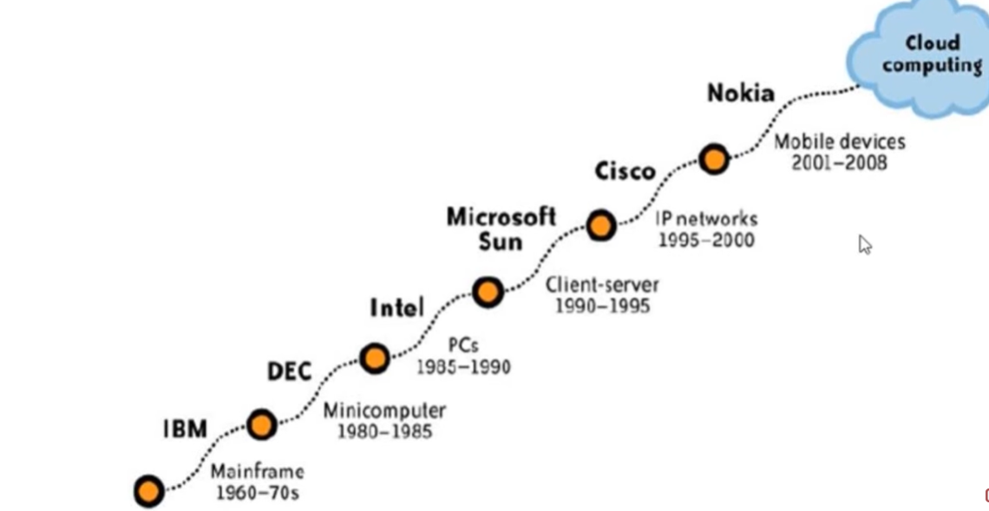
Evaluation of Cloud Computing

Slide 5
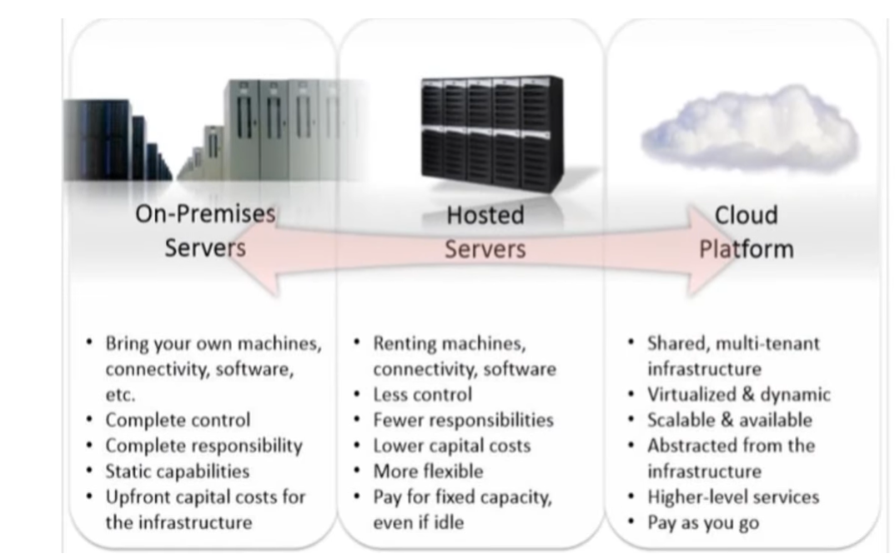

Slide 6

What is Cloud Computing ?
What do they say ?

Slide 7

Cloud Definitions
Definition from NIST (National Institute of Standards and Technology)
Cloud computing is a model for enabling convenient, on-demand network access to a shared pool of configurable computing resources (e.g., networks, servers, storage, applications, and services) that can be rapidly provisioned and released with minimal management effort or service provider interaction.
This cloud model promotes availability and is composed of five essential characteristics, three service models, and four deployment models.

Slide 8
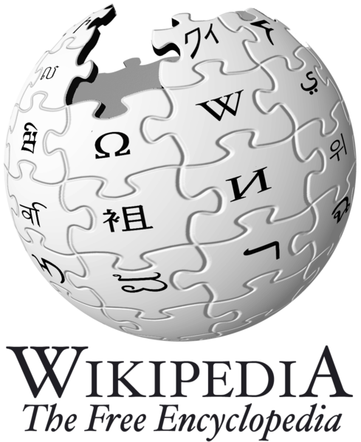
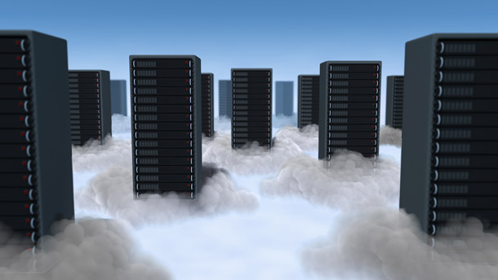
Cloud Definitions
Definition from Wikipedia
Cloud computing is Internet-based computing, whereby shared resources, software, and information are provided to computers and other devices on demand, like the electricity grid.
Cloud computing is a style of computing in which dynamically scalable and often virtualized resources are provided as a service over the Internet.

Slide 9
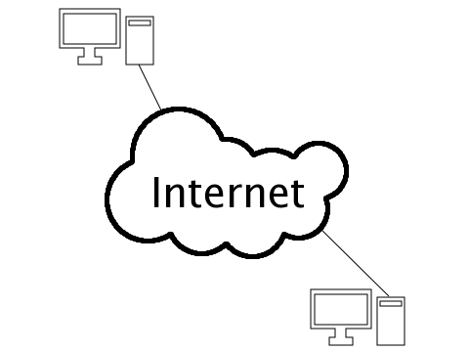
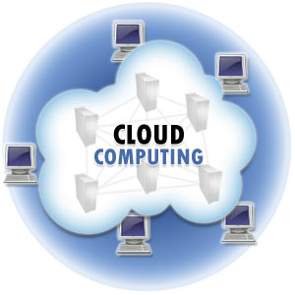
Cloud Definitions
The name cloud computing was inspired by the cloud symbol that's often used to represent the Internet in flowcharts and diagrams. Cloud computing is a general term for anything that involves delivering hosted services over the Internet.

Slide 10

Cloud Definitions
Definition from Berkeley
Cloud Computing refers to both the applications delivered as services over the Internet and the hardware and systems software in the datacenters that provide those services.
The services themselves have long been referred to as Software as a Service (SaaS), so we use that term. The datacenter hardware and software is what we will call a Cloud.
When a Cloud is made available in a pay-as-you-go manner to the public…… The service being sold is Utility Computing.

Slide 11
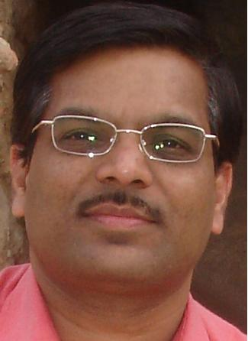
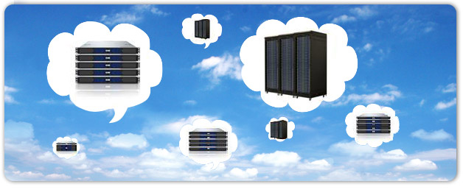
Cloud Definitions
Definition from Buyya
A Cloud is a type of parallel and distributed system consisting of a collection of interconnected and virtualized computers that are dynamically provisioned and presented as one or more unified computing resources based on service-level agreements established through negotiation between the service provider and consumers.

Slide 12
Even More Confusing ??

Slide 13
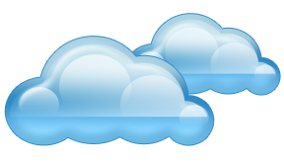
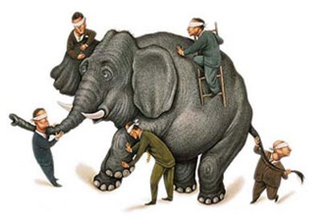
What is Cloud computing ?
Properties and characteristics

Slide 14

In Our Humble Opinion
Cloud computing is a paradigm of computing, a new way of thinking about IT industry but not any specific technology.
Central ideas
Utility Computing
SOA - Service Oriented Architecture
SLA - Service Level Agreement
Properties and characteristics
High scalability and elasticity
High availability and reliability
High manageability and interoperability
High accessibility and portability
High performance and optimization
Enabling techniques
Hardware virtualization
Parallelized and distributed computing
Web service

Slide 15
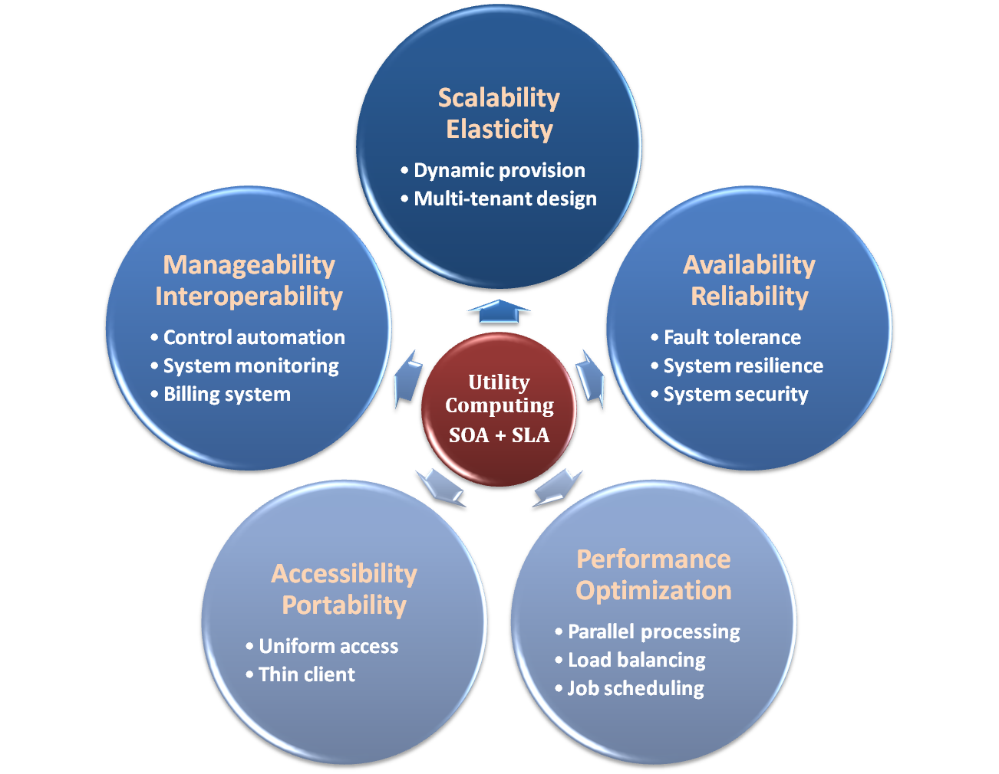

Properties and Characteristics

Slide 16

Central Ideas
Utility Computing SOA + SLA
Don’t tell me details!!
I DON’T CARE!!

Slide 17

Central Ideas
Utility Computing SOA + SLA
Perspective from user :
Users do not care about how the works are done
Instead, they only concern about what they can get
Users do not care about what the provider actually did
Instead, they only concern about their quality of service
Users do not want to own the physical infrastructure
Instead, they only want to pay as many as they used
What dose user really care ?
They only care about their “Service”

Slide 18
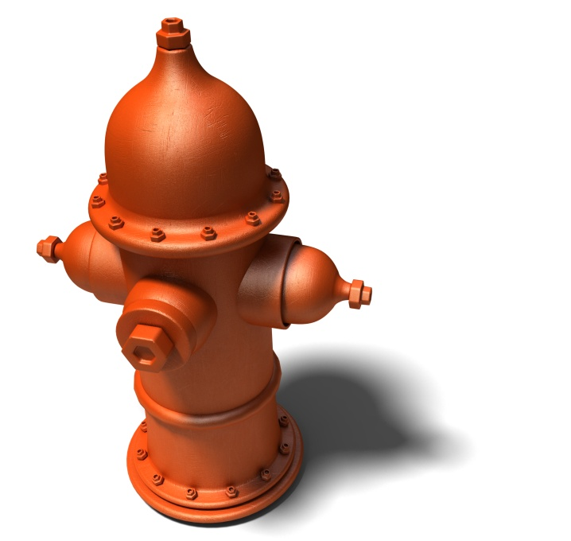
Utility Computing
Utility Computing SOA + SLA
One service provisioning model
Service provider makes computing resources and infrastructure management available to the customer as needed, and charges them for specific usage rather than a flat rate.
Like other types of on-demand computing , the utility model seeks to maximize the efficient use of resources and/or minimize associated costs.

Slide 19
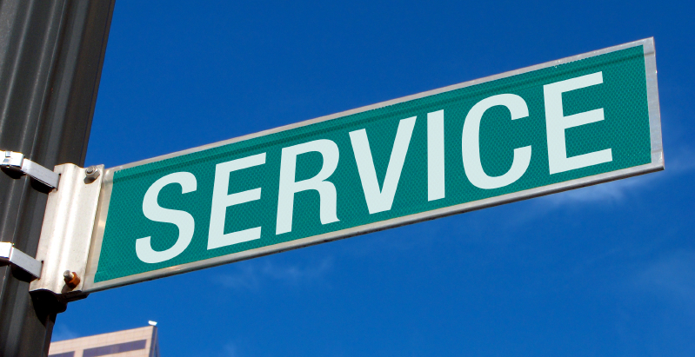
What Is Service?
Utility Computing SOA + SLA
Service is what you connect together using Web Services.
Service is the endpoint of a connection.
Functionalities of service :
A service should be well-defined
A service should be self-contained
A service should not depend on the context or state of other services.

Slide 20
What Is Web Service?
Utility Computing SOA + SLA
Definition :
Web service is self-describing and stateless modules that perform discrete units of work and are available over the network
Web service providers offer APIs that enable developers to exploit functionality over the Internet, rather than delivering full-blown applications
Web Services Description Language (WSDL) :
Expressed in XML which include both data type and messages
Four types of operations :
One-way - Messages sent without a reply required
Request & response - Sending and replying messages
Solicit response - A request for a response
Notification - Messages sent to multiple receivers

Slide 21
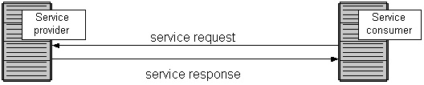
Service Oriented Architecture
Utility Computing SOA + SLA
Definition
Service Oriented Architecture (SOA) is essentially a collection of services which communicate with each other
Contain a flexible set of design principles used during the phases of systems development and integration
Provide a loosely-integrated suite of services that can be used within multiple business domains
Approach
Usually implemented by Web Service model

Slide 22

Quality Of Service
Utility Computing SOA + SLA
Original definition
Quality of Service (QoS) is a set of technologies for managing network traffic in a cost effective manner to enhance user experiences for home and enterprise environments.
Now QoS becomes to a broad term that is used following areas :
Customer care evaluations
Technological evaluations

Slide 23
Quality Of Service
Utility Computing SOA + SLA
Customer care evaluations
QoS is usually measured in terms of issues that have a direct impact on the experience of the customer
Only issues that produce a negative effect on the goods and services received by the customer come under scrutiny
Technological evaluations
QoS has to do with the efficient operation of various systems
This can lead to adjusting procedures or adapting software programs and code to achieve the desired effect while making a more efficient use of available resources

Slide 24

Service Level Agreement
Utility Computing SOA + SLA
Definition
A service-level agreement (SLA) is a contract between a network service provider and a customer that specifies, usually in measurable terms (QoS), what services the network service provider will furnish
Common content in contract
Performance guarantee metrics
Up-time and down-time ratio
System throughput
Response time
Problem management detail
Penalties for non-performance
Documented security capabilities

Slide 25
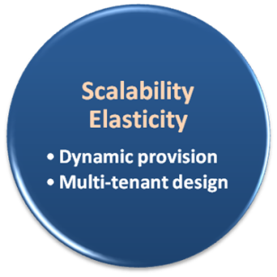

Scalability & Elasticity
Give me the world without limitation!!

Slide 26
Scalability & Elasticity
What is scalability ?
A desirable property of a system, a network, or a process, which indicates its ability to either handle growing amounts of work in a graceful manner or to be readily enlarged.
What is elasticity ?
The ability to apply a quantifiable methodology that allows for the basis of an adaptive introspection with in a real time infrastructure.
But how to achieve these properties ?
Dynamic provisioning
Multi-tenant design

Slide 27
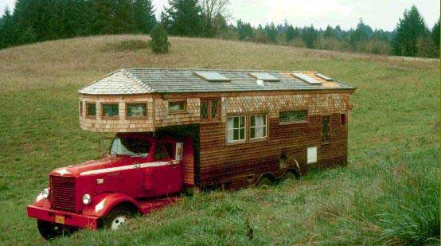
Dynamic Provisioning
What is dynamic provisioning ?
Dynamic Provisioning is a simplified way to explain a complex networked server computing environment where server computing instances are provisioned or deployed from a administrative console or client application by the server administrator, network administrator, or any other enabled user.

Slide 28
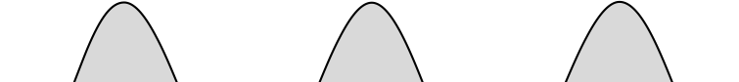
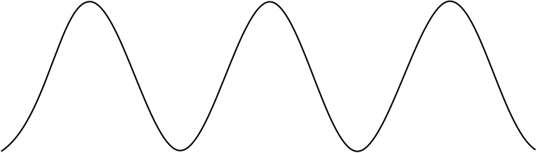
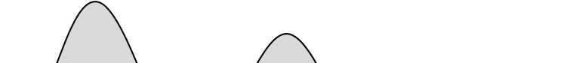

Dynamic Provisioning
In traditional computing model, two common problems :
Underestimate system utilization which result in under provision
Loss Revenue
Resources
Capacity
Resources
Demand
Capacity
1
2
3
Demand
Loss Users
Resources
Capacity
1
2
3
Time (days)
Demand
1
2
3

Slide 29
Dynamic Provisioning
Overestimate system utilization which result in low utilization
How to solve this problem ??
Dynamically provision resources
Capacity
Resources
Unused resources
Demand
Time

Slide 30
Dynamic Provisioning
Cloud resources should be provisioned dynamically
Meet seasonal demand variations
Meet demand variations between different industries
Meet burst demand for some extraordinary events
Resources
Capacity
Resources
Capacity
Demand
Demand
Time
Time

Slide 31
Multi-tenant Design
What is multi-tenant design ?
Multi-tenant refers to a principle in software architecture where a single instance of the software runs on a server, serving multiple client organizations.
With a multi-tenant architecture, a software application is designed to virtually partition its data and configuration thus each client organization works with a customized virtual application instance.
Client oriented requirements :
Customization
Multi-tenant applications are typically required to provide a high degree of customization to support each target organization's needs.
Quality of service
Multi-tenant applications are expected to provide adequate levels of security and robustness.

Slide 32
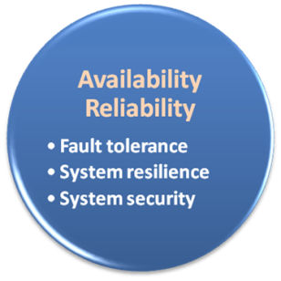

Availability & Reliability
Data Never Loss Machine Never Fail

Slide 33
Availability & Reliability
What is availability ?
The degree to which a system, subsystem, or equipment is in a specified operable and committable state at the start of a mission, when the mission is called for at an unknown time.
Cloud system usually require high availability
Ex. “Five Nines” system would statistically provide 99.999% availability
What is reliability ?
The ability of a system or component to perform its required functions under stated conditions for a specified period of time.
But how to achieve these properties ?
Fault tolerance system
Require system resilience
Reliable system security

Slide 34
Fault Tolerance
What is fault tolerant system ?
Fault-tolerance is the property that enables a system to continue operating properly in the event of the failure of some of its components.
If its operating quality decreases at all, the decrease is proportional to the severity of the failure, as compared to a naively-designed system in which even a small failure can cause total breakdown.
Four basic characteristics :
No single point of failure
Fault detection and isolation to the failing component
Fault containment to prevent propagation of the failure
Availability of reversion modes

Slide 35

Fault Tolerance
Single Point Of Failure (SPOF)
A part of a system which, if it fails, will stop the entire system from working.
The assessment of a potentially single location of failure identifies the critical components of a complex system that would provoke a total systems failure in case of malfunction.
Preventing single point of failure
If a system experiences a failure, it must continue to operate without interruption during the repair process.

Slide 36

Fault Tolerance
Fault Detection and Isolation (FDI)
A subfield of control engineering which concerns itself with monitoring a system, identifying when a fault has occurred and pinpoint the type of fault and its location.
Isolate failing component
When a failure occurs, the system must be able to isolate the failure to the offending component.

Slide 37
Fault Tolerance
Fault Containment
Some failure mechanisms can cause a system to fail by propagating the failure to the rest of the system.
Mechanisms that isolate a rogue transmitter or failing component to protect the system are required.
Available of reversion modes
System should be able to maintain some check points which can be used in managing the state changes.

Slide 38
System Resilience
What is resilience ?
Resilience is the ability to provide and maintain an acceptable level of service in the face of faults and challenges to normal operation.
In other words, if a risk event knocks a system offline, a highly resilient system will return back to work and function as planned as soon as possible.
Some risk events
If power is lost at a plant for two days, can our system recover ?
If a key service is lost because a database corruption, can the business recover ?

Slide 39

System Resilience
Disaster Recovery
Disaster recovery is the process, policies and procedures related to preparing for recovery or continuation of technology infrastructure critical to an organization after a natural or human-induced disaster.
Some common strategies :
Backup
Make data off-site at regular interval
Replicate data to an off-site location
Replicate whole system
Preparing
Local mirror systems
Uninterruptible Power Supply (UPS)

Slide 40
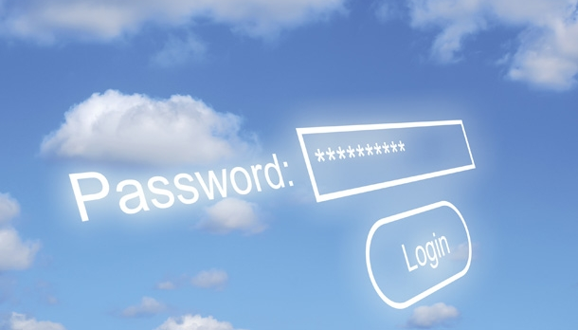
System Security
Security issue in Cloud Computing :
Cloud security is an evolving sub-domain of computer security, network security, and, more broadly, information security.
It refers to a broad set of policies, technologies, and controls deployed to protect data, applications, and the associated infrastructure of cloud computing.

Slide 41
System Security
Important security and privacy issues :
Data Protection
To be considered protected, data from one customer must be properly segregated from that of another.
Identity Management
Every enterprise will have its own identity management system to control access to information and computing resources.
Application Security
Cloud providers should ensure that applications available as a service via the cloud are secure.
Privacy
Providers ensure that all critical data are masked and that only authorized users have access to data in its entirety.

Slide 42
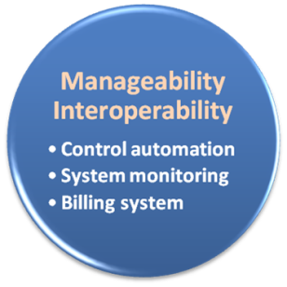

Manageability & Interoperability
I Want Full Control !!

Slide 43
Manageability & Interoperability
What is manageability ?
Systems manageability is strongly influenced by network management initiatives in telecommunications.
What is interoperability ?
Interoperability is a property of a product or system, whose interfaces are completely understood, to work with other products or systems, present or future, without any restricted access or implementation.
But how to achieve these properties ?
System control automation
System state monitoring

Slide 44
Control Automation
Four functional areas :
Self-Configuration
Automatic configuration of components.
Self-Healing
Automatic discovery, and correction of faults.
Self-Optimization
Automatic monitoring and control of resources to ensure the optimal functioning with respect to the defined requirements.
Self-Protection
Proactive identification and protection from arbitrary attacks.

Slide 45
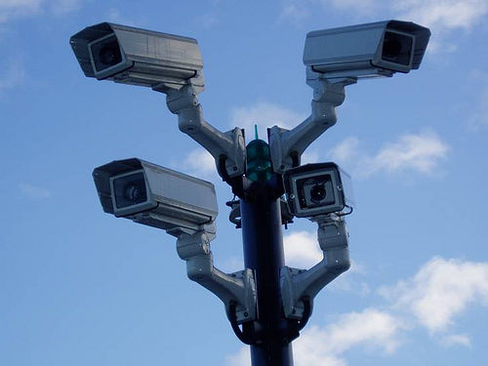
System Monitoring
What is system monitor ?
A System Monitor in systems engineering is a process within a distributed system for collecting and storing state data.
What should be monitored in the Cloud ?
Physical and virtual hardware state
Resource performance metrics
Network access patterns
System logs
… etc
Anything more ?
Billing system

Slide 46

Billing System
Billing System in Cloud
Users pay as many as they used.
Cloud provider must first determine the list of service usage price.
Cloud provider have to record the resource or service usage of each user, and then charge users by these records.
How can cloud provider know users’ usage ?
Get those information by means of monitoring system.
Automatically calculate the total amount of money which user should pay. And automatically request money from use’s banking account.

Slide 47
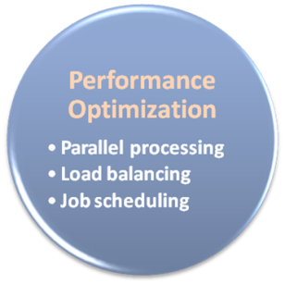

Performance & Optimization
High Performance Improvement

Slide 48
Performance & Optimization
Performance guarantees ??
As the great computing power in cloud, application performance should be guaranteed.
Cloud providers make use of powerful infrastructure or other underlining resources to build up a highly performed and highly optimized environment, and then deliver the complete services to cloud users.
But how to achieve this property ?
Parallel computing
Load balancing
Job scheduling

Slide 49
Parallel Processing
Parallel Processing
Parallel processing is a form of computation in which many calculations are carried out simultaneously, operating on the principle that large problems can often be divided into smaller ones, which are then solved concurrently.
Parallelism in different levels :
Bit level parallelism
Instruction level parallelism
Data level parallelism
Task level parallelism

Slide 50
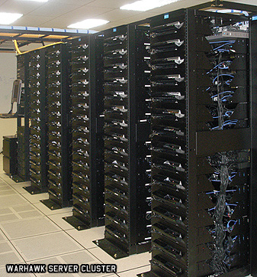
Parallel Processing
Hardware approaches
Multi-core computer
Symmetric multi-processor
General purpose graphic processing unit
Vector processor
Distributed computing
Cluster computing
Grid computing
Software approaches
Parallel programming language
Automatic parallelization

Slide 51

Load Balancing
What is load balancing ?
Load balancing is a technique to distribute workload evenly across two or more computers, network links, CPUs, hard drives, or other resources, in order to get optimal resource utilization, maximize throughput, minimize response time, and avoid overload.
Why should be load balanced ?
Improve resource utilization
Improve system performance
Improve energy efficiency
Unbalanced

Slide 52
Job Scheduling
What is job scheduler ?
A job scheduler is a software application that is in charge of unattended background executions, commonly known for historical reasons as batch processing.
What should be scheduled in Cloud ?
Computation intensive tasks
Dynamic growing and shrinking tasks
Tasks with complex processing dependency
How to approach ?
Use pre-defined workflow
System automatic configuration

Slide 53
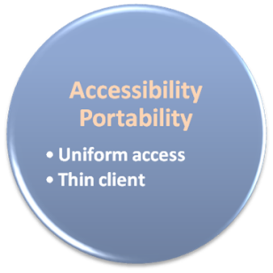

Accessibility & Portability
Anyone !
Anytime !
Anywhere !

Slide 54
Accessibility & Portability
What is accessibility ?
Accessibility is a general term used to describe the degree to which a product, device, service, or environment is accessible by as many people as possible.
What is service portability ?
Service portability is the ability to access services using any devices, anywhere, continuously with mobility support and dynamic adaptation to resource variations.
But how to achieve these properties ?
Uniform access
Thin client

Slide 55
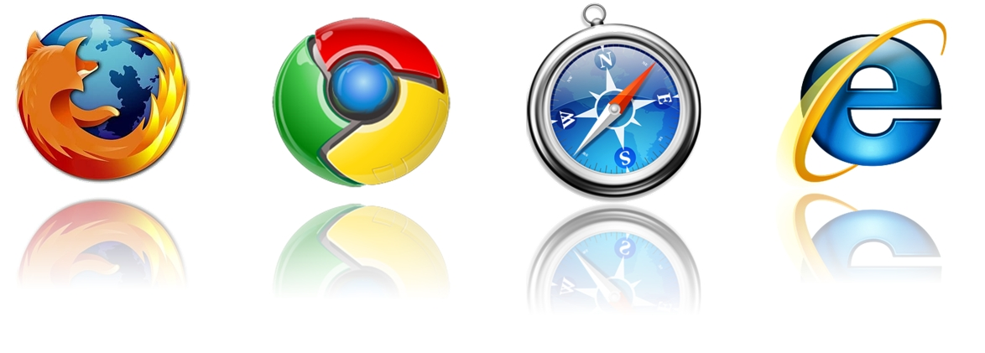
Uniform Access
How do users access cloud services ?
Cloud provider should provide their cloud service by means of widespread accessing media. In other word, users from different operating systems or other accessing platforms should be able to directly be served.
Nowadays, web browser technique is one of the most widespread platform in almost any intelligent electronic devices. Cloud service take this into concern, and delivery their services with web-based interface through the Internet.

Slide 56
Thin Client
What is thin client ?
Thin client is a computer or a computer program which depends heavily on some other computer to fulfill its traditional computational roles. This stands in contrast to the traditional fat client, a computer designed to take on these roles by itself.
Characteristics :
Cheap client hardware
While the cloud providers handle several client sessions at once, the clients can be made out of much cheaper hardware.
Diversity of end devices
End user can access cloud service via plenty of various electronic devices, which include mobile phones and smart TV.
Client simplicity
Client local system do not need complete operational functionalities.

